Slide 1

Ahsanullah University Of Science & Technology
Dept Of Computer Science & Engineering
Hosted By
Solaiman Salvi Sir & Anik sir
Presented by
Name:MD. Rashidul Hoque Bappi
ID:14.01.04.044
Name: Proma Ahmed
ID:14.01.04.039
Slide no:1

Slide 2


Slide 3

Features
Score:
The Live score is shown.
Difficulty:
They are Easy, Medium, Hard.
Game Play:
Some will fall from the top. Fish will catch it.. Then it will give point. Also some bomb will fall. If bombs are eaten then player will loose on life.

Slide 4
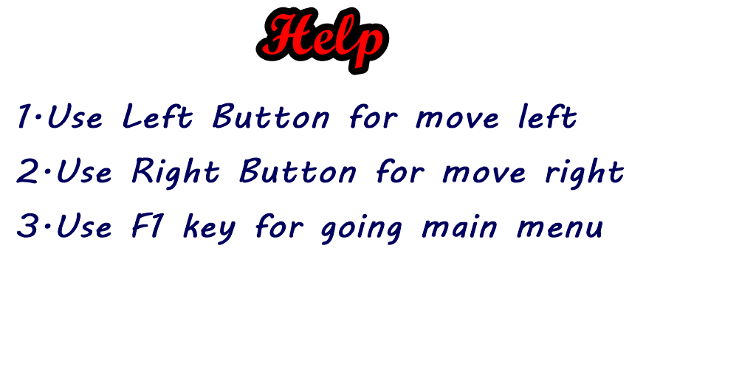

Slide 5









BOMBS:
Foods:

Slide 6
Thank you

